Slide 1

Library Traffic
Team ID: 2
Matthew Hughes, Joseph Terranova
"Projects" class, Professor Hanh Pham, Spring 2023

Slide 2
Outline
1. Summary
1.1 Business Context and Goals
1.2 Technical Requirements
1.3 Responsibilities
2. Description of Solution
2.1 System Architecture
2.2 Programming Components
3. Tests/Experiments
4. Technologies
4.1 Related Technologies
4.2 Newly Learned Technologies
5. Conclusions/Challenges

Slide 3

1. Summary
Camera mounted above the entrance of the library to track the number of people entering and leaving
Data is collected and sent to a database in real time
Library staff can access the data through a user-friendly dashboard
Data includes the number of visitors, busiest times of the day, and peak days of the week

Slide 4
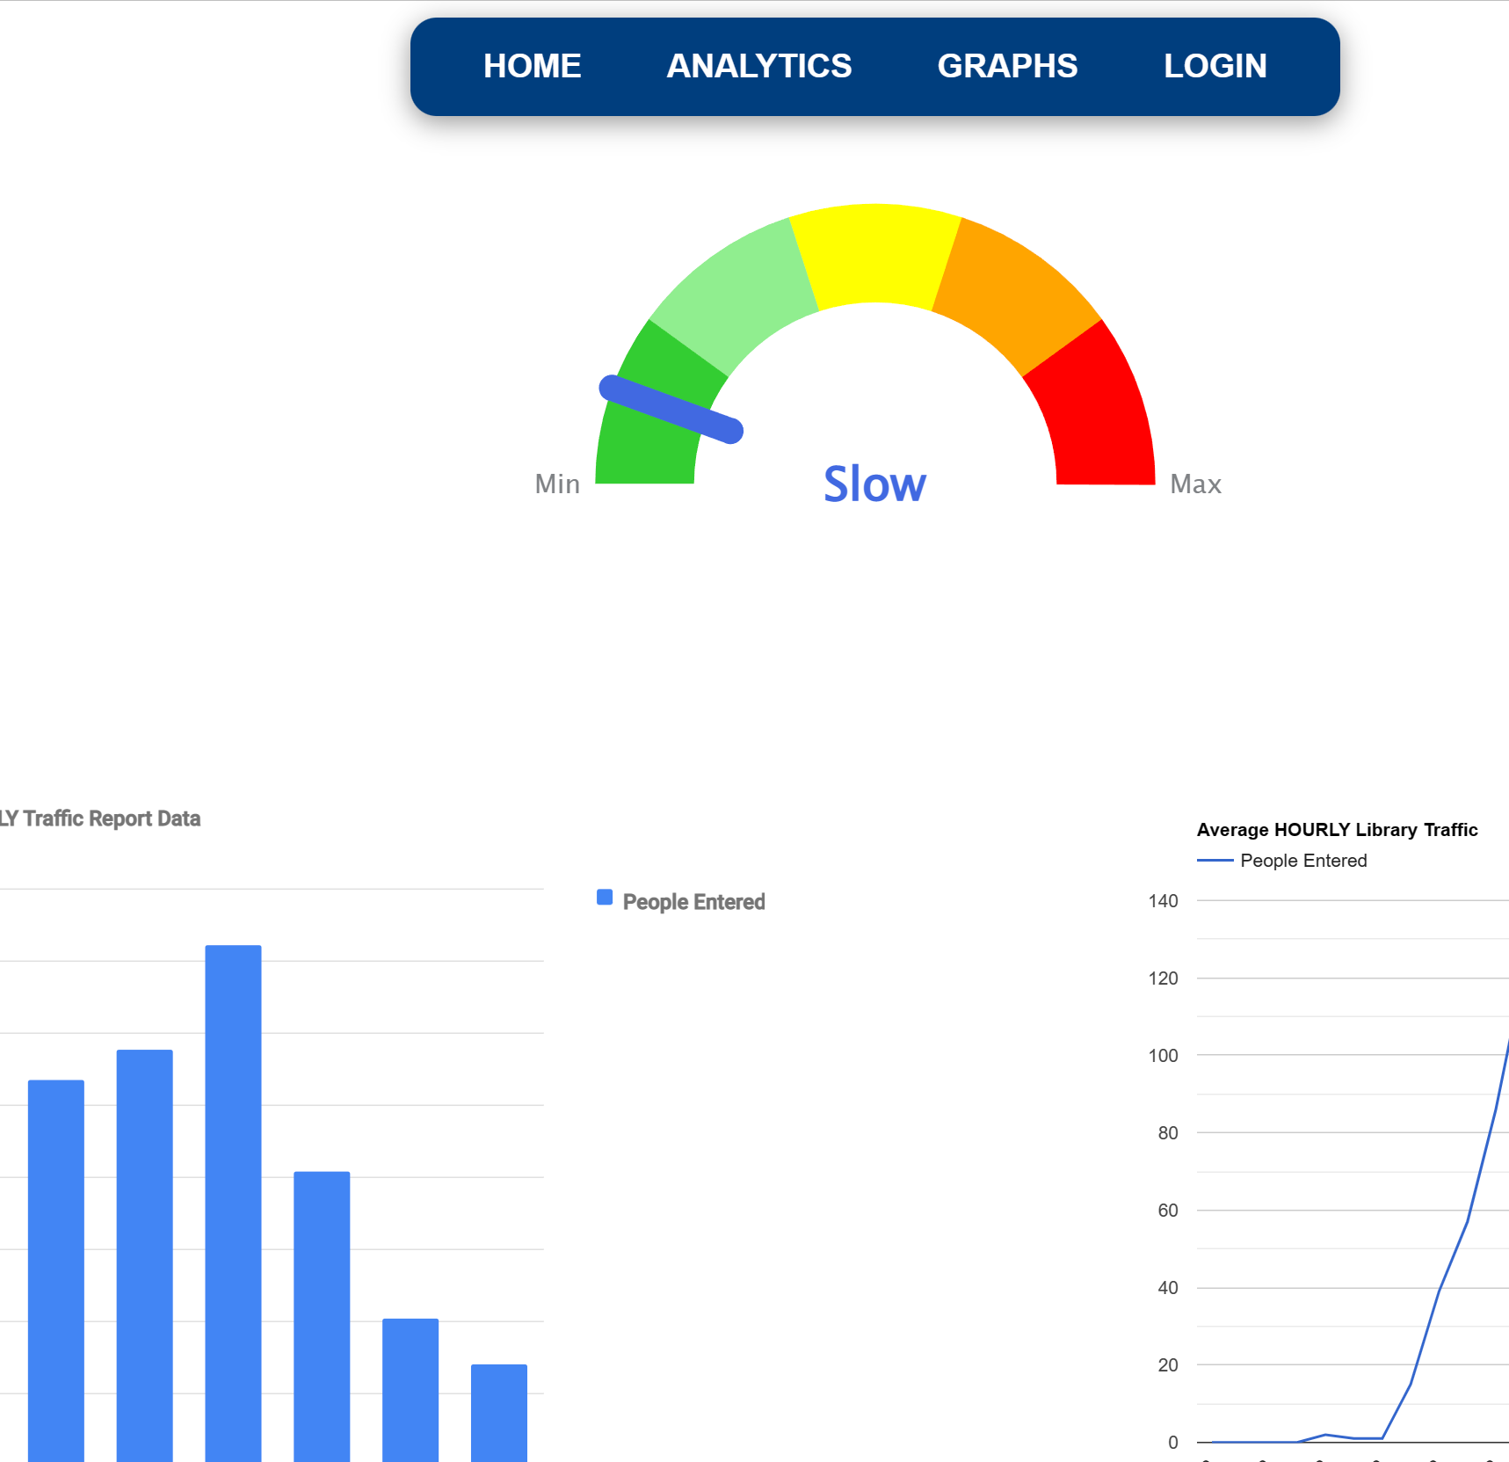
1.1 Business Context and Goals
Business Context:
User/client is the library staff
The library staff wants to have a better understanding of the library's usage patterns to improve the overall experience for students and faculty
Goals:
Accurately record those who enter and exit the library
To provide real time library usage to the library staff
Analyze data to identify trends and patterns in library usage

Slide 5
1.2 Technical Requirements
Hardware
PC
HikVision dual lens camera
Software
HikVision
Web browser
Data
MySQL database
HikVision

Slide 6
1.3 Responsibilities
Fix the filters and have them work with real data instead of the mock data
Creating new versions of the filters
Organize file structure
Create a cleaner and more consistent UI
Reorganize page design to make it easier for users to move between pages

Slide 7
2. Description of Solution

Slide 8
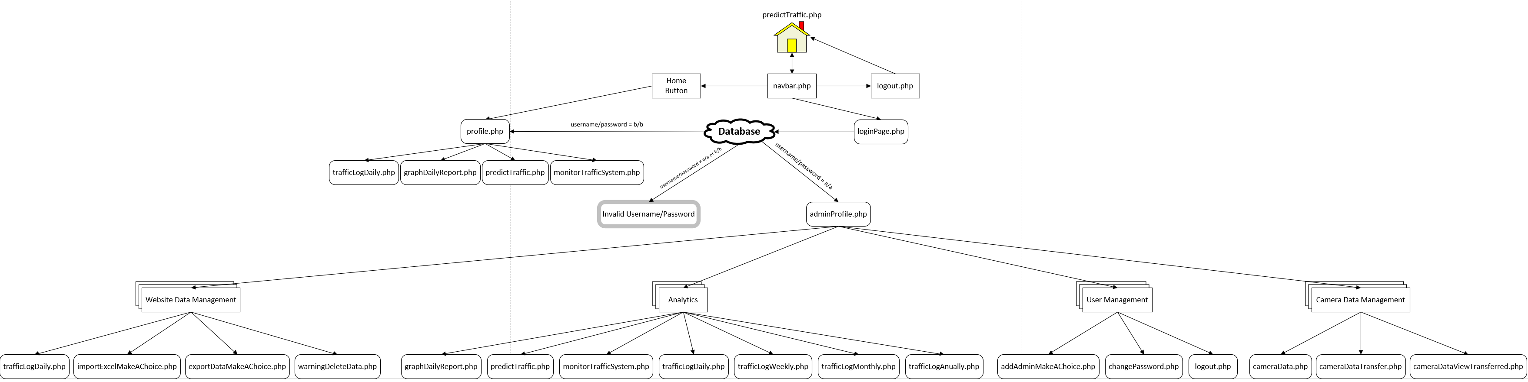
2.1 System Architecture

Slide 9

2.2 Programming Components

Slide 10
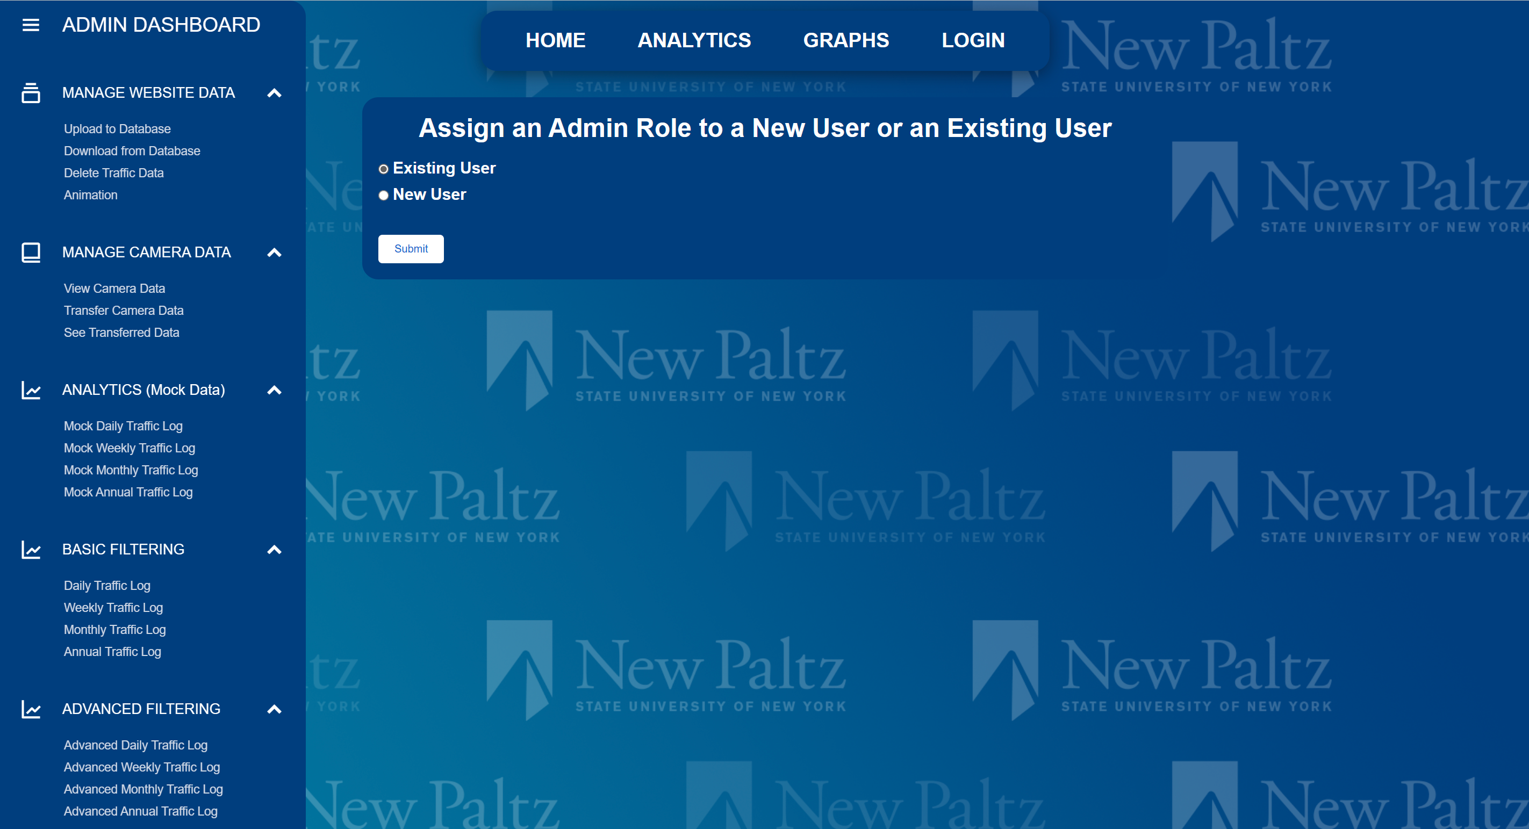
Navbar and sidebar
The navbar and sidebar are separate pages that are implemented using include statements on necessary pages for easier maintainability

Slide 11
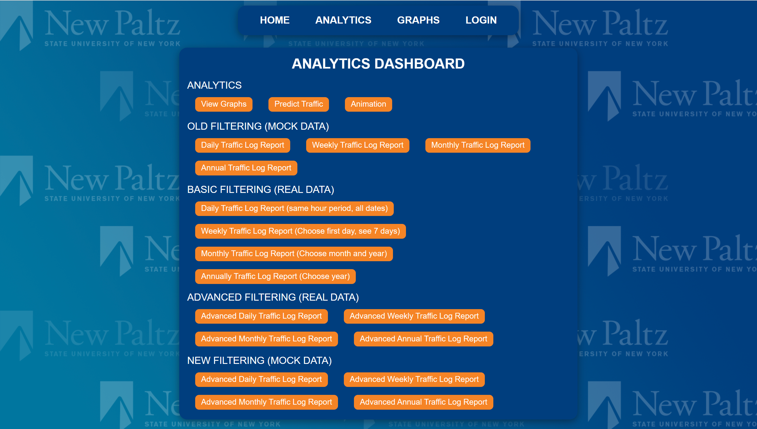
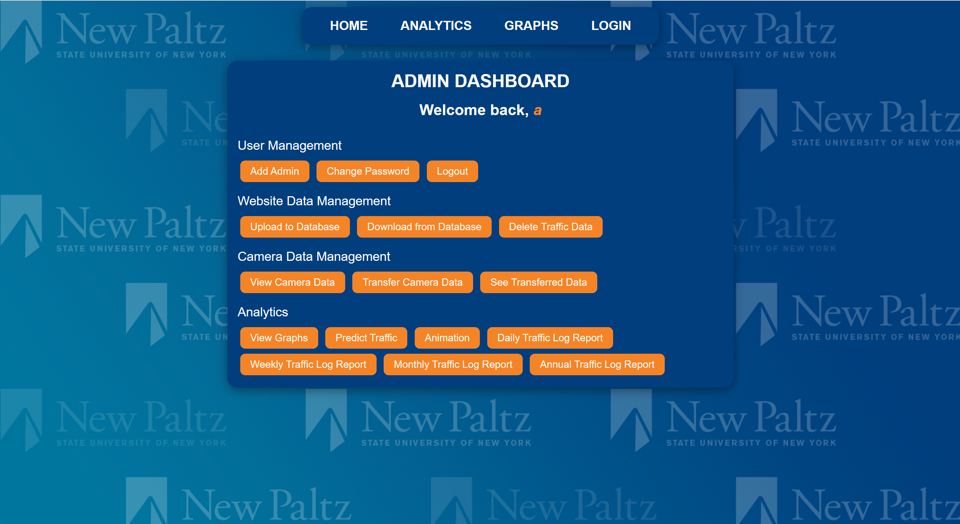
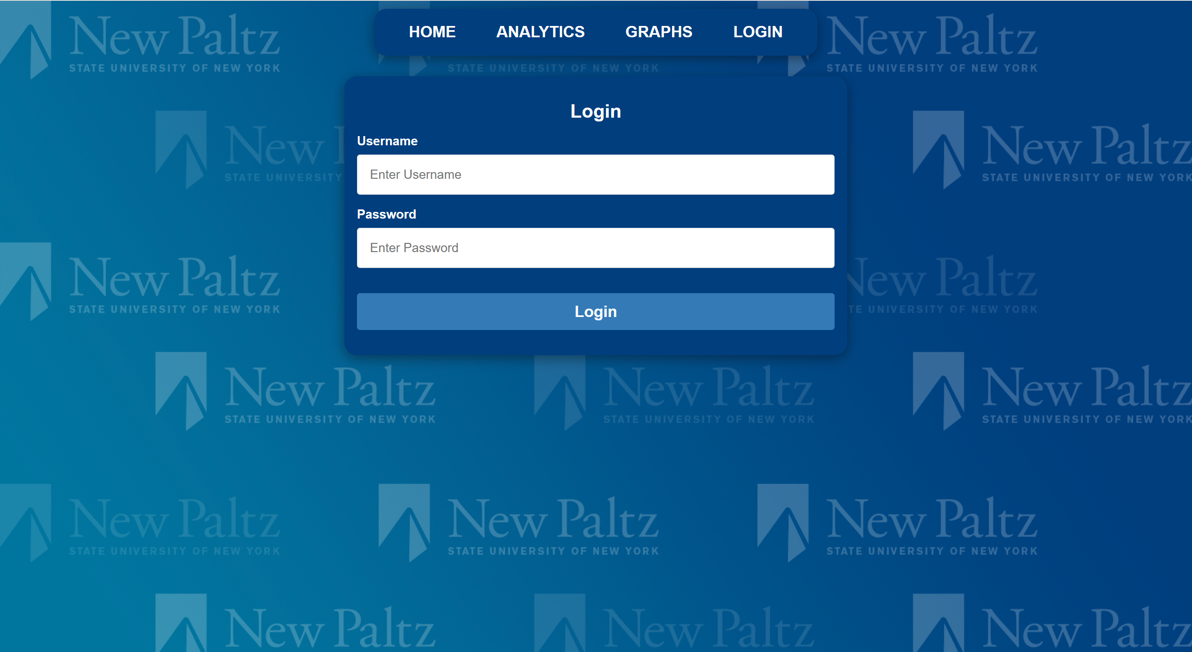
Analytics Dashboard, Admin Dashboard, Login page
These pages are more consistent and cleaner looking to help create a seamless experience across the site

Slide 12
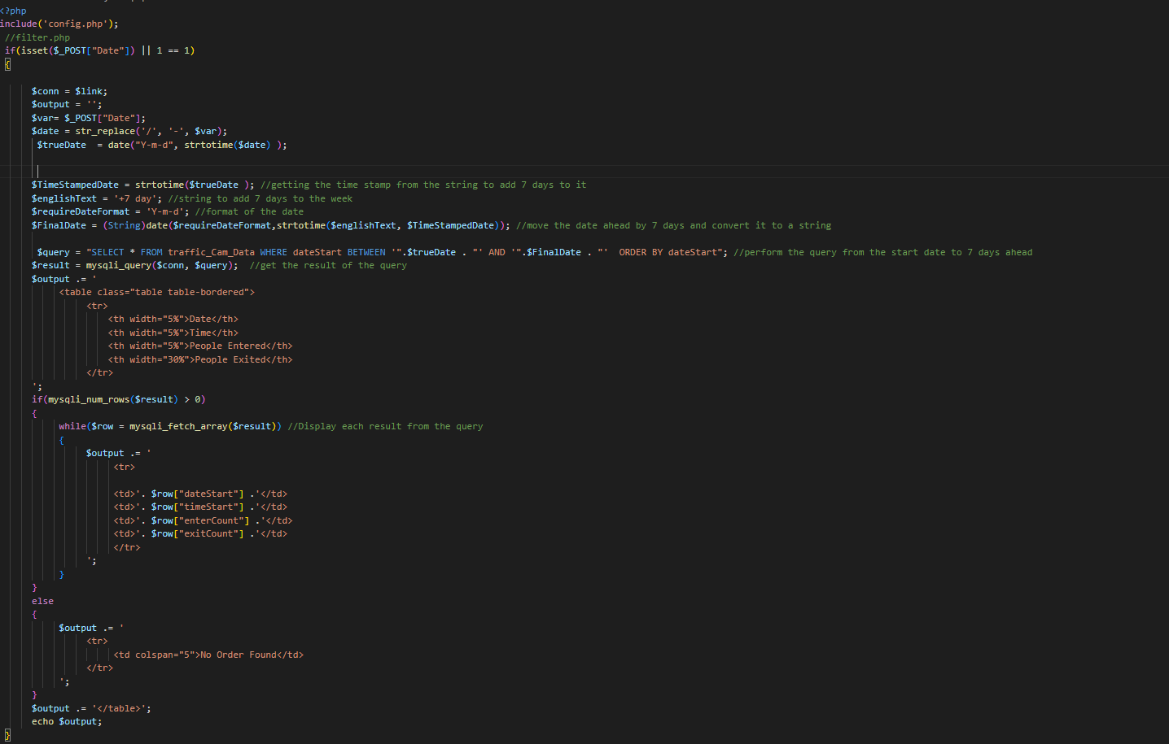
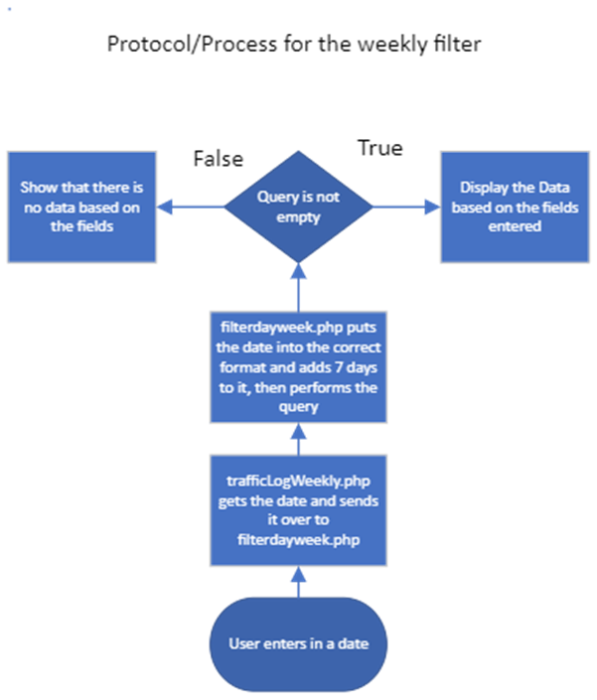
Weekly Filter

Slide 13
3. Tests/Experiments

Slide 14
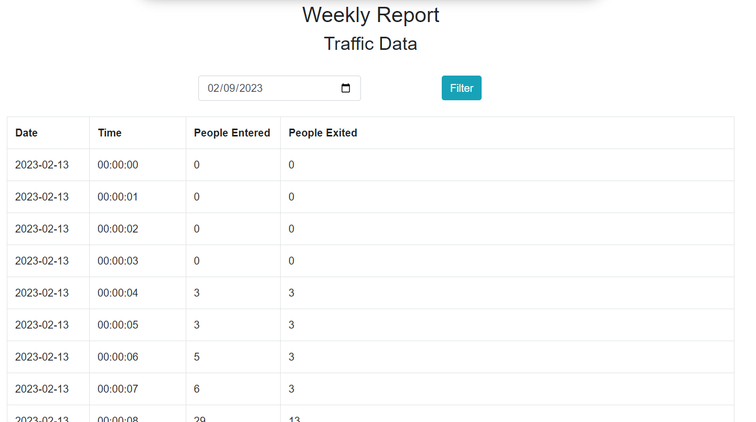
3. Tests/Experiments
For filtering I would develop test cases for each that would match what I thought would be the desired outcome then proceed with formatting the user input

Slide 15
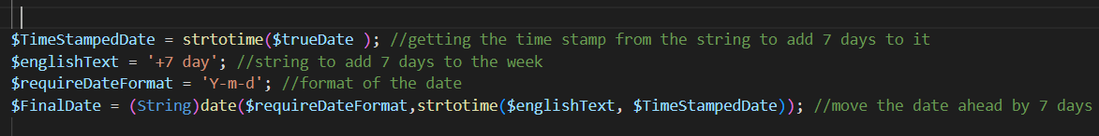
3.Tests/Experiments
For experimenting I found a useful function within PHP that would allow me to easily format the user input called "strotime".

Slide 16

4. Technologies

Slide 17
4.1 Related Technologies
HTML
CSS
Python
MySQL
JavaScript
PHP
HikVision camera

Slide 18

4.2 Newly Learned Technologies
PHP
MySQL

Slide 19

5. Conclusions/Challenges
Conclusions:
General UI and UX is cleaner
Working filters with real data
Better file structure
Challenges:
Interpreting preexisting code
Identifying and prioritizing changes that need to be made to improve the site

